Slide 1

Branches 54 & 94 Luncheon
The History
of SIR
Past
Present
Andy Danver, Branch 35 (Palo Alto)
SIR Inc - Dir of Marketing & Communication
April 10, 2025
Future

Slide 2
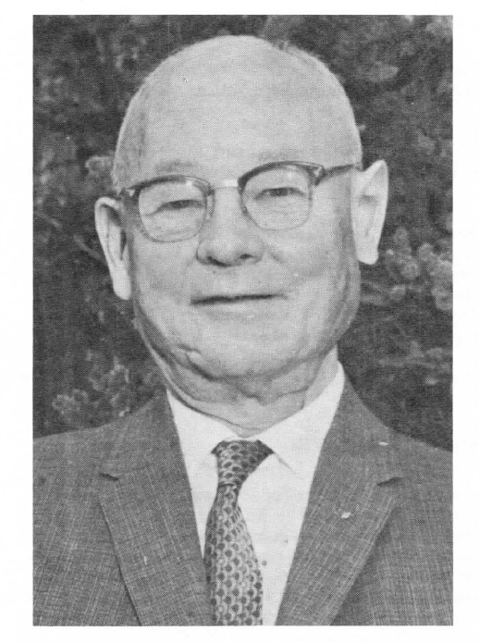
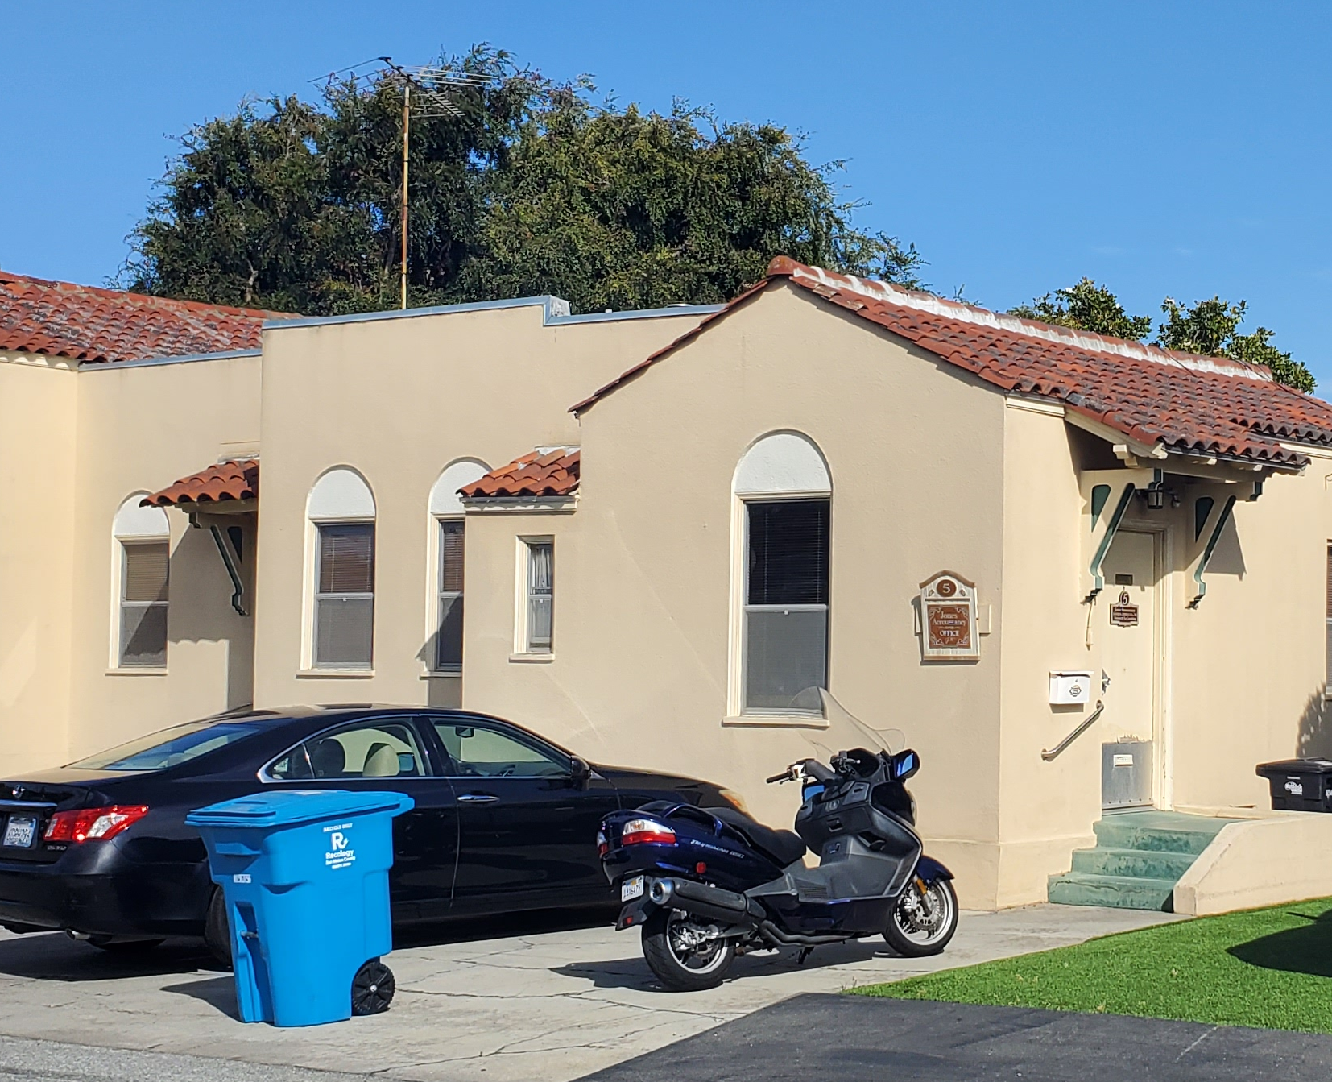
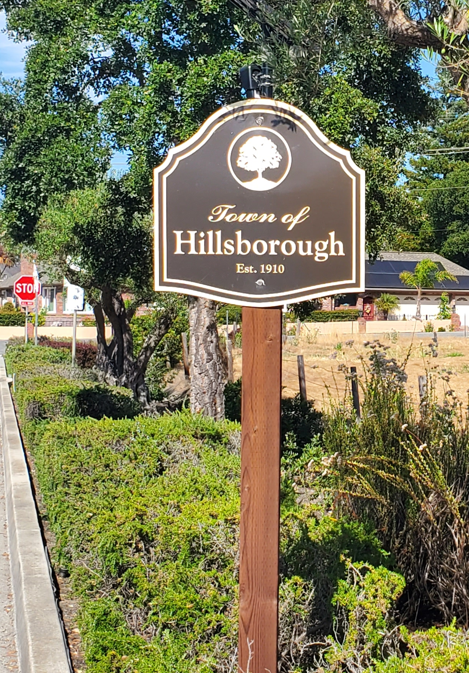
The Founder…
& Rule Maker in 1958
Royal Order of Jesters
444 Penisula Ave #5
San Mateo
Damian L Reynolds
1892 - 1965

Slide 3
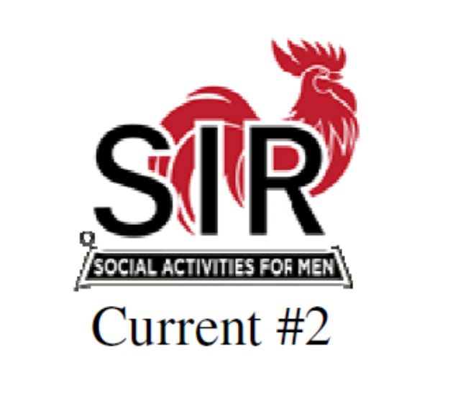
Original Slogan:
Promoting the Independence and Dignity of Retirement
Original Mission Statement:
A luncheon club for retired men for the purpose of maintaining olde friendships, making new acquaintances and avoiding the boredom of retirement ___________________________________________________________________
Current Slogan:
Enhance your Lifestyle and Make Friends for Life
Current Mission Statement:
SIR exists to enrich the lives of its members through fun activities, luncheons and events while making friends for life

Slide 4


One thing remains the Same
SIR is run entirely by volunteers
Without Your hard work
Nothing would get done,
Nothing would work.
SIR Inc would not exist!
** Thank You **

Slide 5
What Name Gets Your Vote ?
Ancient & Honorable
Sons of Rest
Faithful Old Fellows
Fellow Oldsters
League of Aimless Fellows
Restful Sons
Sons in Retirement
The Honey Dews
Work Dodgers Luncheon Club
Young Oldster

Slide 6
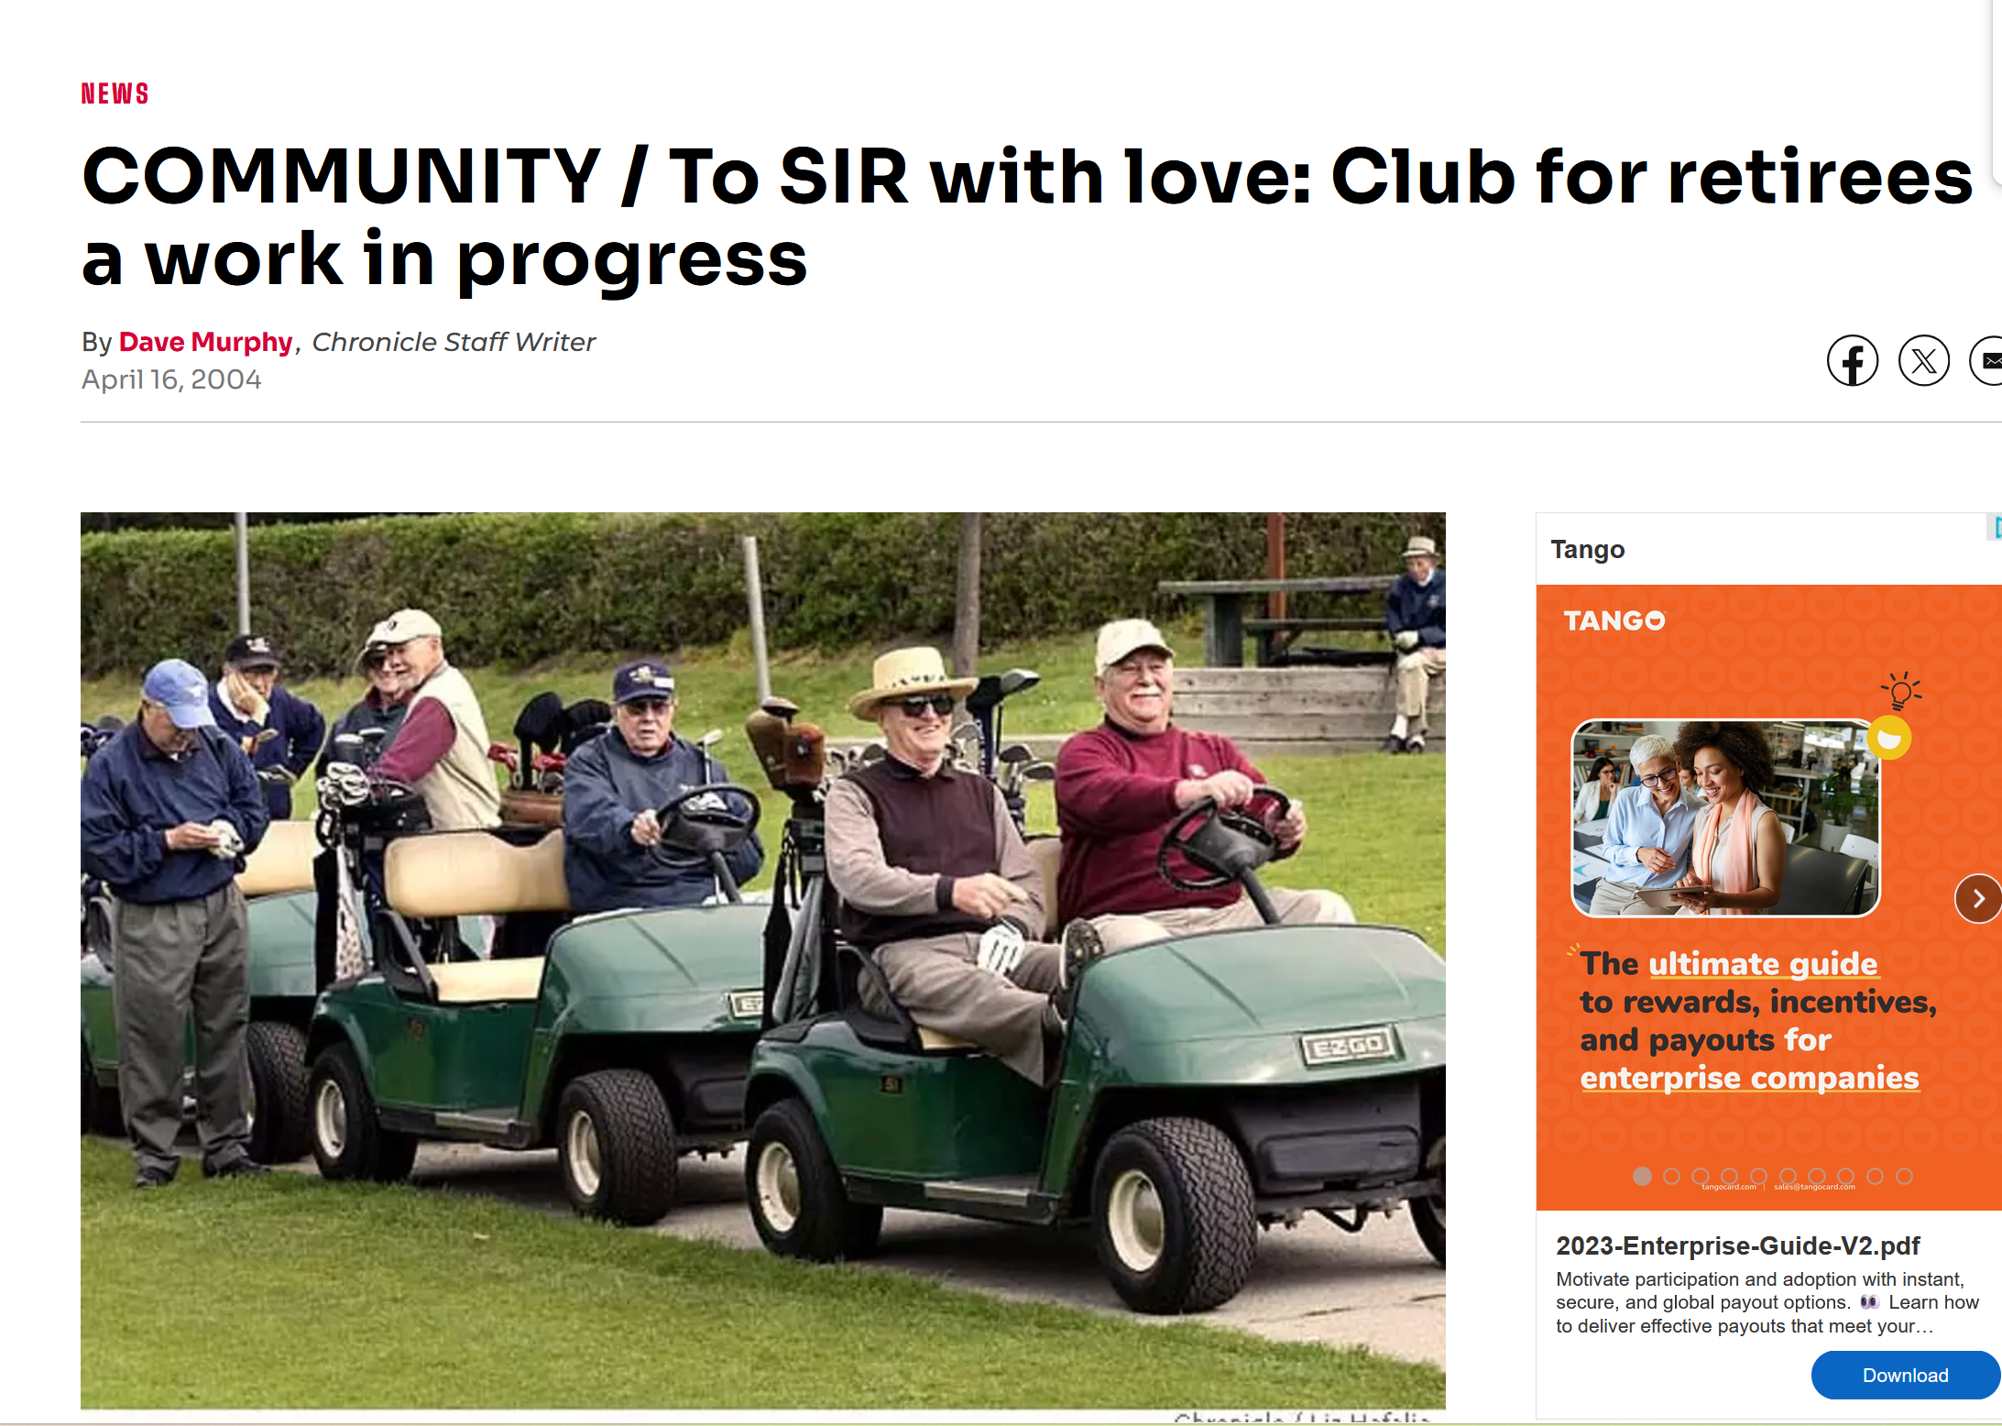
Growth through Press Releases
Promo in SF Gate – April 2004

Slide 7
First 10 Branches - Geographically Close
1 | Peninsula | San Mateo | 1959-02-03
2 | East Bay | Berkeley | 1961-01-25
3 | Camelina City | Sacramento | 1961-10-18
4 | San Francisco | San Francisco | 1962-06-06
5 | Southern Peninsula | Palo Alto | 1962-09-26
6 | Southern Alameda Cnty | San Leandro | 1963-12-26
7 | North Bay | San Rafael | 1963-11-12
8 | Mt Diablo | Walnut Creek | 1965-01-11
9 | Capital City | Sacramento | 1965-02-04
10 | Santa Clara Valley | San Jose | 1965-03-10

Slide 8


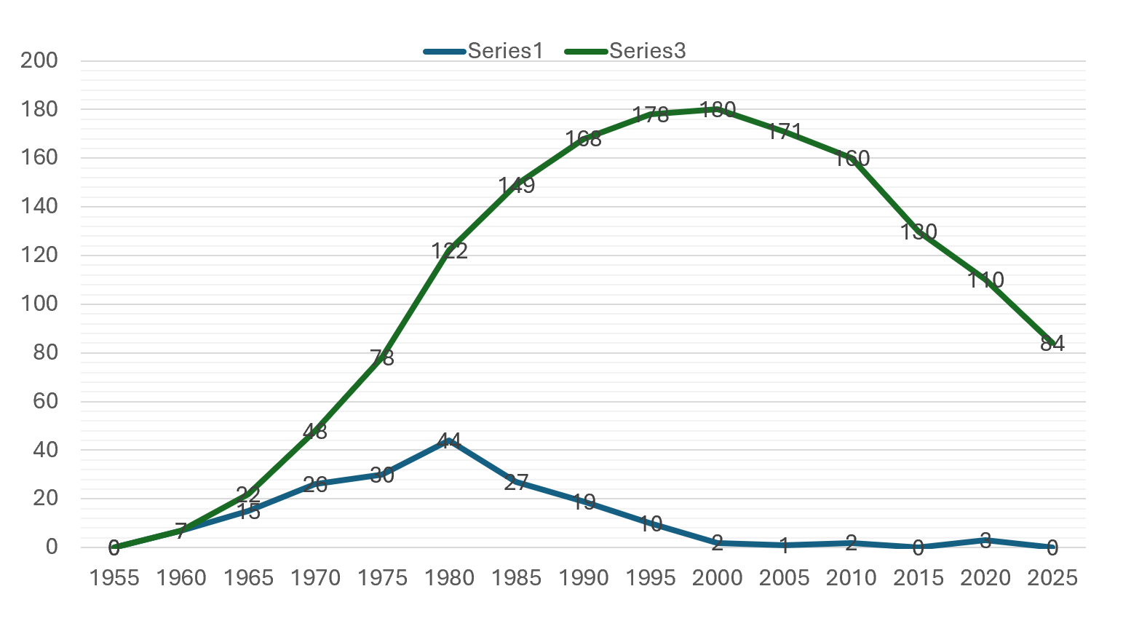
So Where has SIR Been?
Growth in Branches for 45 years
Total Branches
New Branches

Slide 9
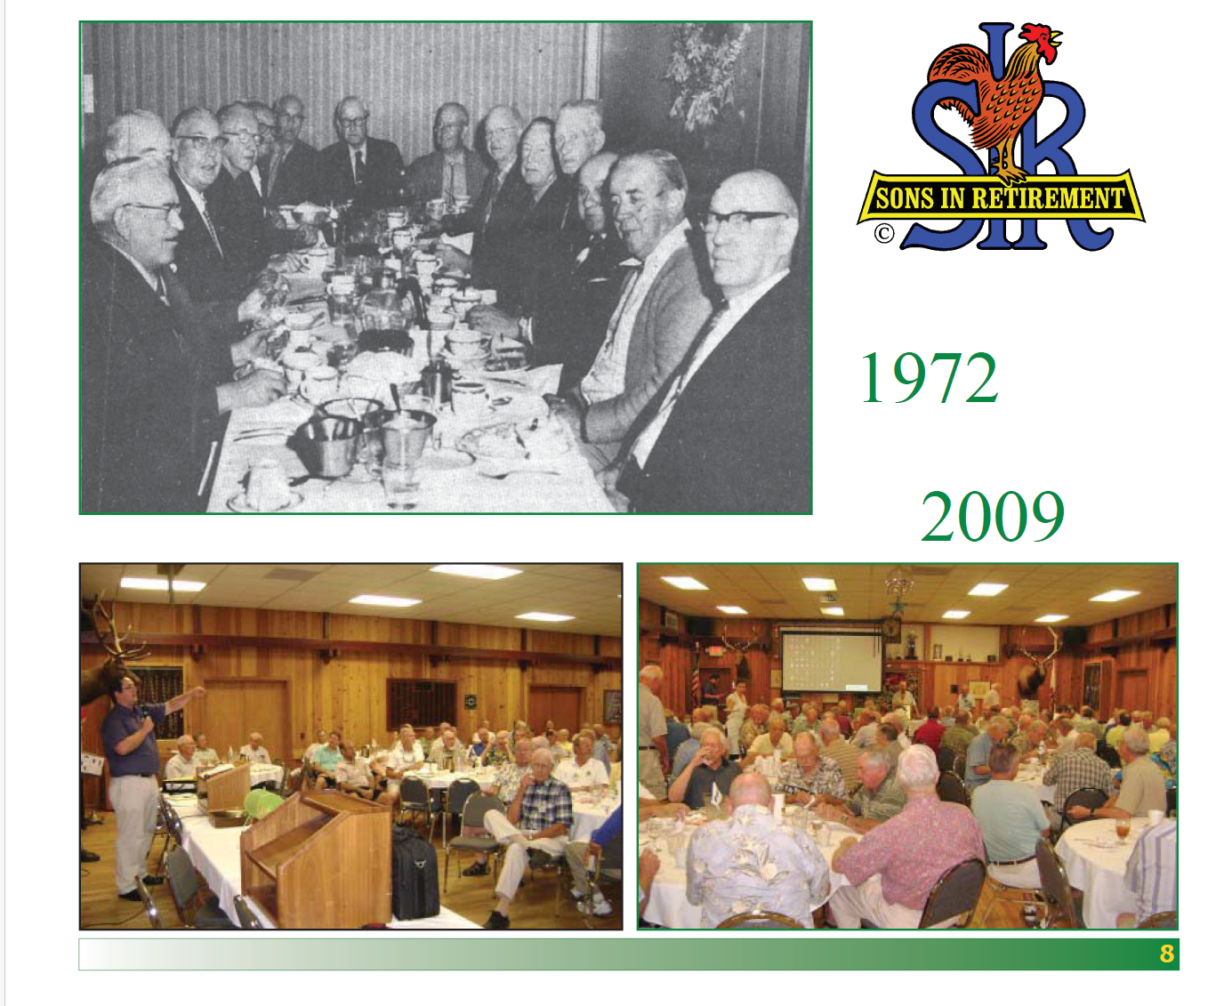


66 Years of Change
1958
2024
Branch 37 - Auburn

Slide 10
This is SIR Inc Today
Mission
Enhance the lives of our members through fun activities, special events, and lunches while forging friendships that last a lifetime.
Vision
Be the best active seniors organization in Northern and Central California by promoting physical, mental, and social engagement which research shows will improve our quality of life and longevity.

Slide 11
State SIR offers Branches
Insures the branches.
Submits branch financials (tax).
Maintains California state documents.
Supports common tools (website, etc.)
Trains branch executives.
Organizes Tournaments and Events
Publishes a monthly newsletter.
Sells SIR apparel and other items.

Slide 12
SIR Inc 2025 Expenses by Category

Slide 13
SIR Inc Available Cash Reserves
Total Per Member
SIR Inc (12/31/23) $70,375 $ 8
SIR Inc (12/31/24) $97,281 $11
Branches Total $486,595 $55
Branches Average $5,951
Branches Median $4,487 $50

Slide 14
We’re Getting Older
# of Members
Younger than 65 (6%)
65 to 74 (23%)
75 to 79 (24%)
80 and Over (47%)
5 Year Age Bands

Slide 15
Most Branches are Shrinking
# of
Branches
32 Growing
5 Flat
27 Fading
13 Folding
Percentage Growth Bands

Slide 16
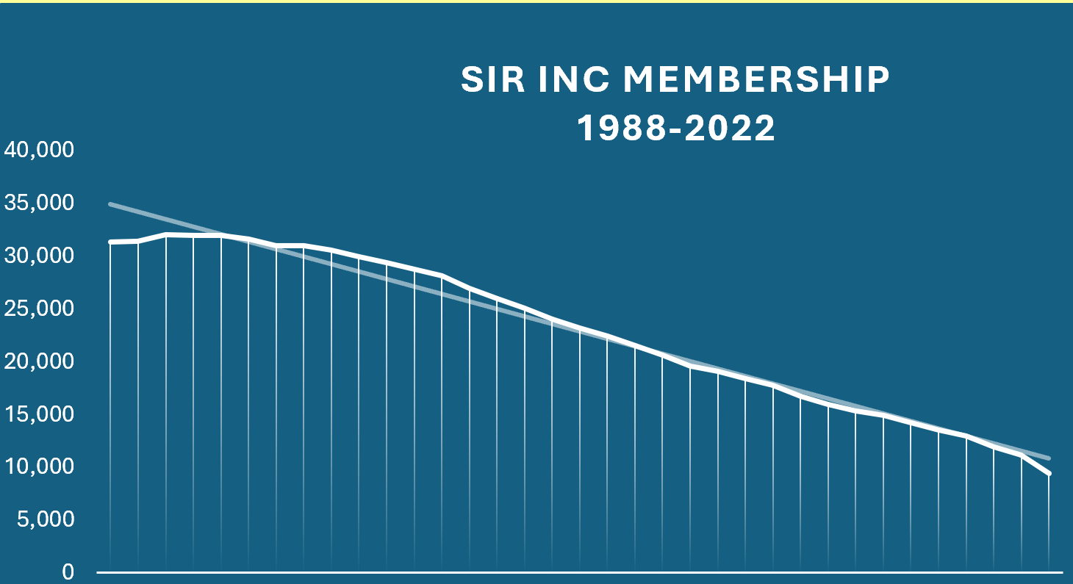
So Where is SIR Inc Going?
How Long can Sir Survive the Loses
31,975 members in 1992
8,640 members in 2024
4% straight line decline
Notes:
We are at a crossroads! I’m going to share some facts regarding the overall health of the organization while at the same time letting you know that the members of the state board of directors has been meeting, reviewing options, debating, seeking outside input, and in general do everything we are REQUIRED to do in order to safeguard the organizations future. And without being too dramatic, that future is not well assured by any stretch of the imagination.
However, I want to make sure that in the spirit of transparency I want everyone to know this is the time to speak up. We are making everyone aware of what state believes is the best course of action to take but you do have a voice.
I also want to share that as an officer of the State Board I am obligated to present these facts and options based on the collective agreement of the board. It’s no different than when holding a position as Big Sir for my branch I was (and am) obligated to represent the positions of my collective branch. While I certainly have personal opinions and they have been expressed in meetings and debates, I stand before you today united with the rest of the state board in our strategy for moving into the future of SIR. I’m asking each of the Big Sirs on this call, acting as a member of the parent corporation to feel comfortable sharing your views and the views of your branches, but also understand that there is a balance that must be factored and weighed with respect to our future.

Slide 17
So Where is SIR Inc Going?
Decline: 4 per year since 2000
Total Branches
New Branches

Slide 18
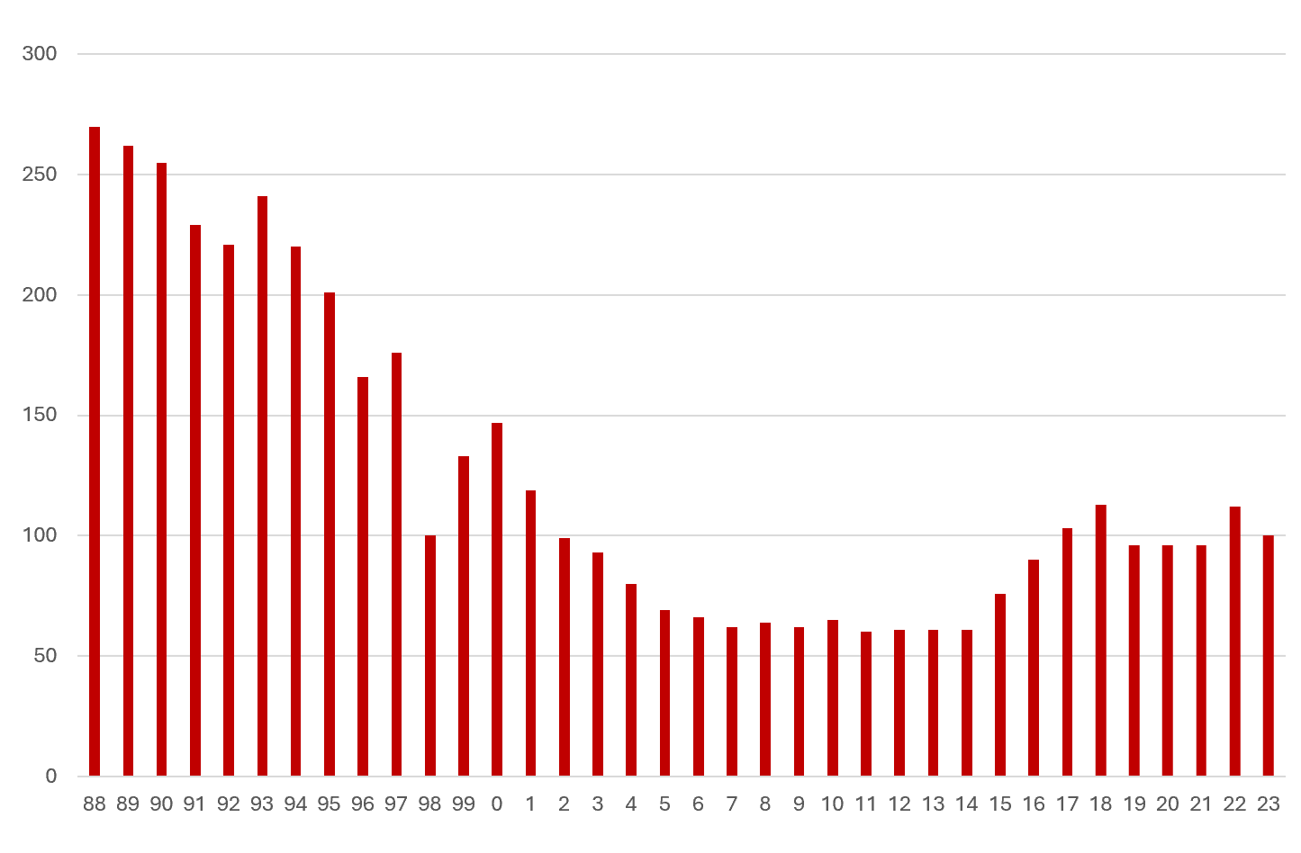
Change in Membership
(Typical Branch)
270 members in 1988
100 members in 2023
Notes:
We are at a crossroads! I’m going to share some facts regarding the overall health of the organization while at the same time letting you know that the members of the state board of directors has been meeting, reviewing options, debating, seeking outside input, and in general do everything we are REQUIRED to do in order to safeguard the organizations future. And without being too dramatic, that future is not well assured by any stretch of the imagination.
However, I want to make sure that in the spirit of transparency I want everyone to know this is the time to speak up. We are making everyone aware of what state believes is the best course of action to take but you do have a voice.
I also want to share that as an officer of the State Board I am obligated to present these facts and options based on the collective agreement of the board. It’s no different than when holding a position as Big Sir for my branch I was (and am) obligated to represent the positions of my collective branch. While I certainly have personal opinions and they have been expressed in meetings and debates, I stand before you today united with the rest of the state board in our strategy for moving into the future of SIR. I’m asking each of the Big Sirs on this call, acting as a member of the parent corporation to feel comfortable sharing your views and the views of your branches, but also understand that there is a balance that must be factored and weighed with respect to our future.

Slide 19
Change in Membership
(Branch 54)
275 members in 1988
73 members in 2024
Notes:
We are at a crossroads! I’m going to share some facts regarding the overall health of the organization while at the same time letting you know that the members of the state board of directors has been meeting, reviewing options, debating, seeking outside input, and in general do everything we are REQUIRED to do in order to safeguard the organizations future. And without being too dramatic, that future is not well assured by any stretch of the imagination.
However, I want to make sure that in the spirit of transparency I want everyone to know this is the time to speak up. We are making everyone aware of what state believes is the best course of action to take but you do have a voice.
I also want to share that as an officer of the State Board I am obligated to present these facts and options based on the collective agreement of the board. It’s no different than when holding a position as Big Sir for my branch I was (and am) obligated to represent the positions of my collective branch. While I certainly have personal opinions and they have been expressed in meetings and debates, I stand before you today united with the rest of the state board in our strategy for moving into the future of SIR. I’m asking each of the Big Sirs on this call, acting as a member of the parent corporation to feel comfortable sharing your views and the views of your branches, but also understand that there is a balance that must be factored and weighed with respect to our future.

Slide 20
Change in Membership
(Branch 94)
275 members in 1988
41 members in 2024
Notes:
We are at a crossroads! I’m going to share some facts regarding the overall health of the organization while at the same time letting you know that the members of the state board of directors has been meeting, reviewing options, debating, seeking outside input, and in general do everything we are REQUIRED to do in order to safeguard the organizations future. And without being too dramatic, that future is not well assured by any stretch of the imagination.
However, I want to make sure that in the spirit of transparency I want everyone to know this is the time to speak up. We are making everyone aware of what state believes is the best course of action to take but you do have a voice.
I also want to share that as an officer of the State Board I am obligated to present these facts and options based on the collective agreement of the board. It’s no different than when holding a position as Big Sir for my branch I was (and am) obligated to represent the positions of my collective branch. While I certainly have personal opinions and they have been expressed in meetings and debates, I stand before you today united with the rest of the state board in our strategy for moving into the future of SIR. I’m asking each of the Big Sirs on this call, acting as a member of the parent corporation to feel comfortable sharing your views and the views of your branches, but also understand that there is a balance that must be factored and weighed with respect to our future.

Slide 21
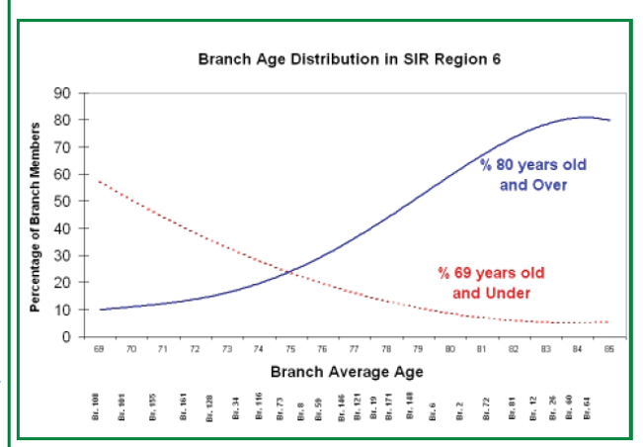
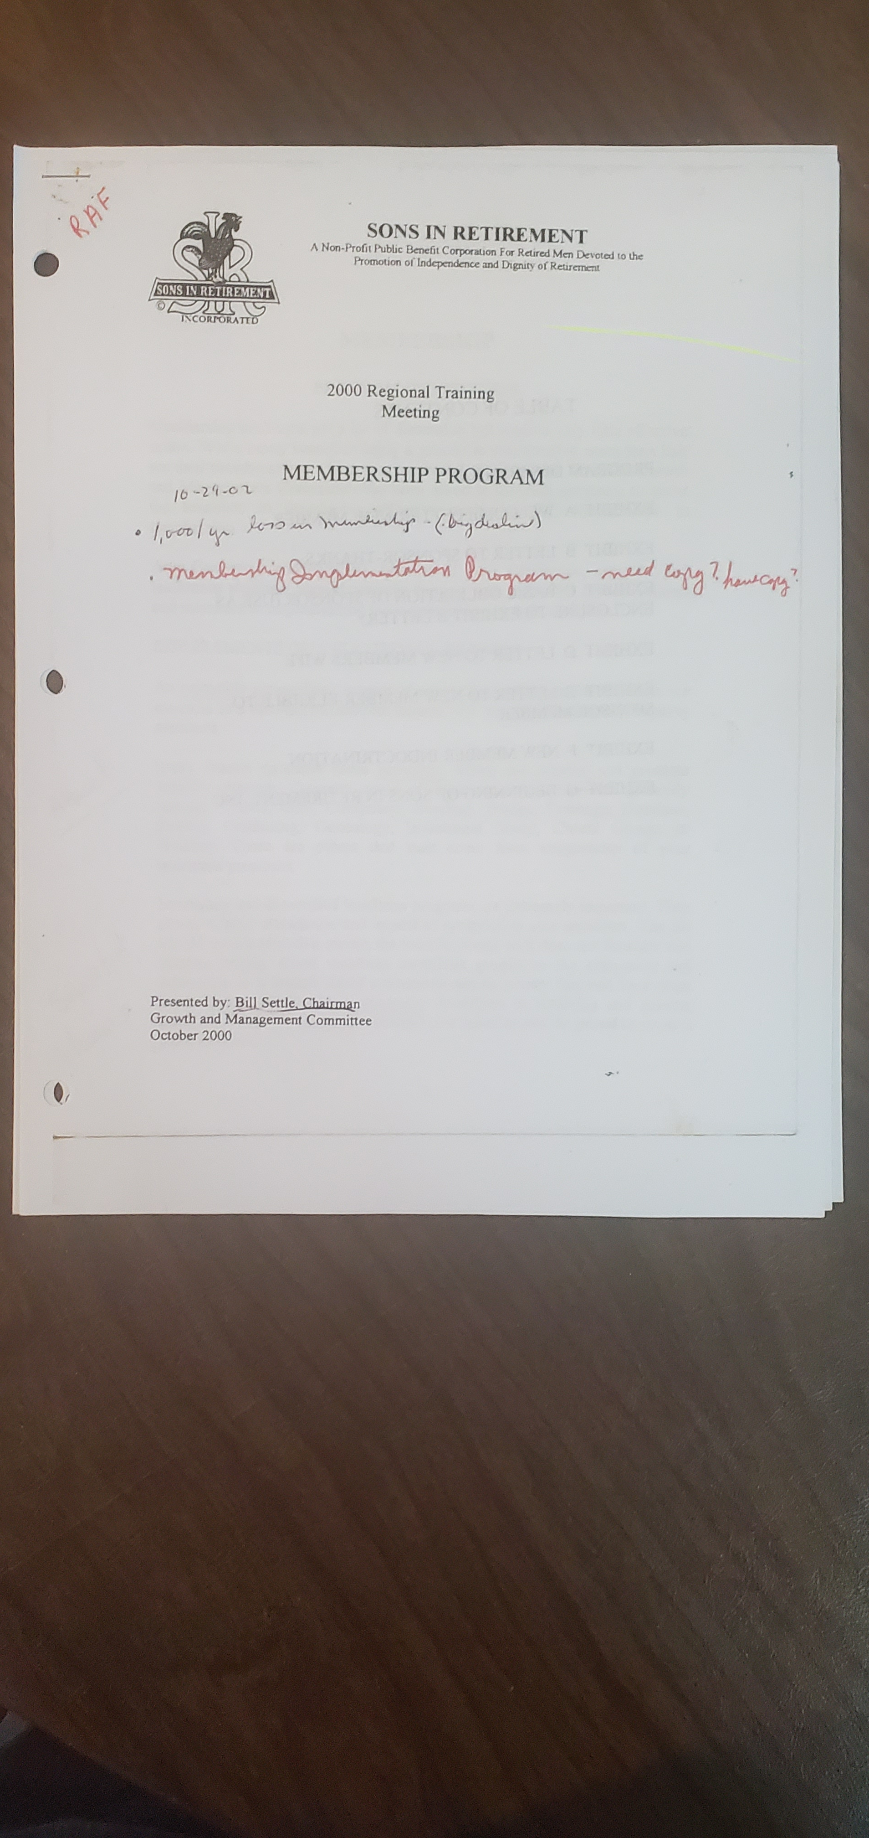
Concern is not new
SIR Membership Growth
October 2000
SIR Annual Meeting
Fall 2008

Slide 22


Membership Growth
Tracks Local Visibility

Slide 23
SIR Membership Growth
Top 9 Branches’ In New Members
 |  |  | Members | Added in | Rank
Area | Branch | Branch Name / City | 12/31/2024 | 2024 | 2024
15 | 128 | San Ramon Valley / San Ramon | 371 | 63 | 1
16 | 146 | Contra Costa / Walnut Creek | 273 | 44 | 2
10 | 17 | Luther Burbank / Santa Rosa | 154 | 41 | 3
3 | 98 | Rocklin / Roseville | 262 | 38 | 4
8 | 7 | North Bay / San Rafael | 106 | 33 | 5
16 | 171 | Lamorinda / Moraga | 153 | 32 | 6
16 | 116 | Las Trampas / Walnut Creek | 183 | 31 | 7
13 | 35 | Mission Trail / Palo Alto | 306 | 30 | 8
7 | 149 | Vine Valley / Napa | 204 | 28 | 9

Slide 24

For Branch Survival
A Must Do List
Attract Younger Members to Join
Encourage New Members to Volunteer
Identify & Mentor New Volunteers to Lead
Make Leading Rewarding & FUN

Slide 25
For Branch Survival
A Must Do List
Make Membership Growth a Priority
Recruit an Energetic Leader
Form a “Young Guns” Committee
Develop a “Local Visibility” Plan
Staff the Plan
Fund the Plan from Reserves

Slide 26
For SIR Survival
An Action Plan
  Improve All Websites – Make visually attractive
  Appear on Social Media – Nextdoor Neighbor ads
  Court Local Print Media - Publish SIR ads in papers
  Implement a 3 G Plan (Great Ground Game)
  Participate in Community Social Event
  Implement a leader recognition plan

Slide 27
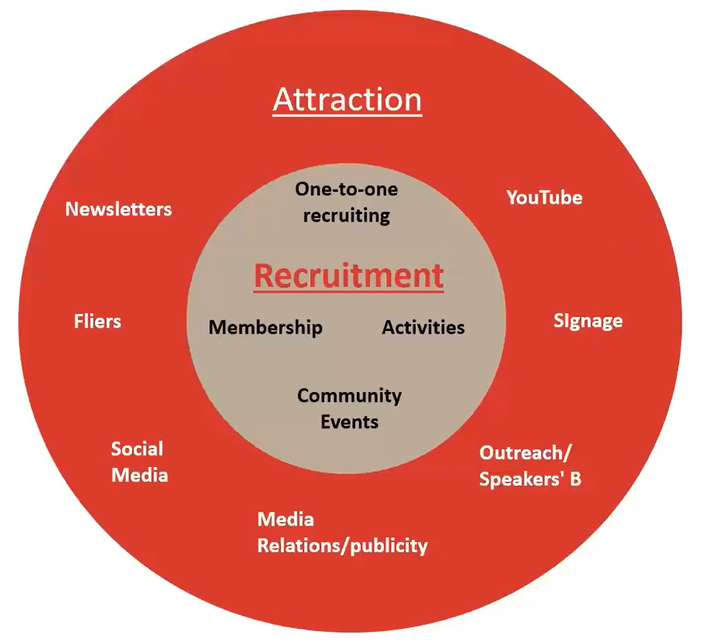
For SIR Survival
An Action Plan from 2021
Implement the
SIR RAMP
Initiative

Slide 28

Increasing SIR Visibility
2025 Plan
Print ads in Central Valley, San Mateo and Los Altos/Mt View
Nextdoor promotions from several branches
NCGA digital eMail promotions NorCal-Wide
Postcard promotions to gated communities in “Gold Country”

Slide 29
SIR County Promotion Plans
Print in Local Papers
- Three Months Minimum
- Multiple Columns
- Every Other Edition
Regional Magazines
Website e-Editions
Nextdoor

Slide 30

Central Valley Ad

Slide 31
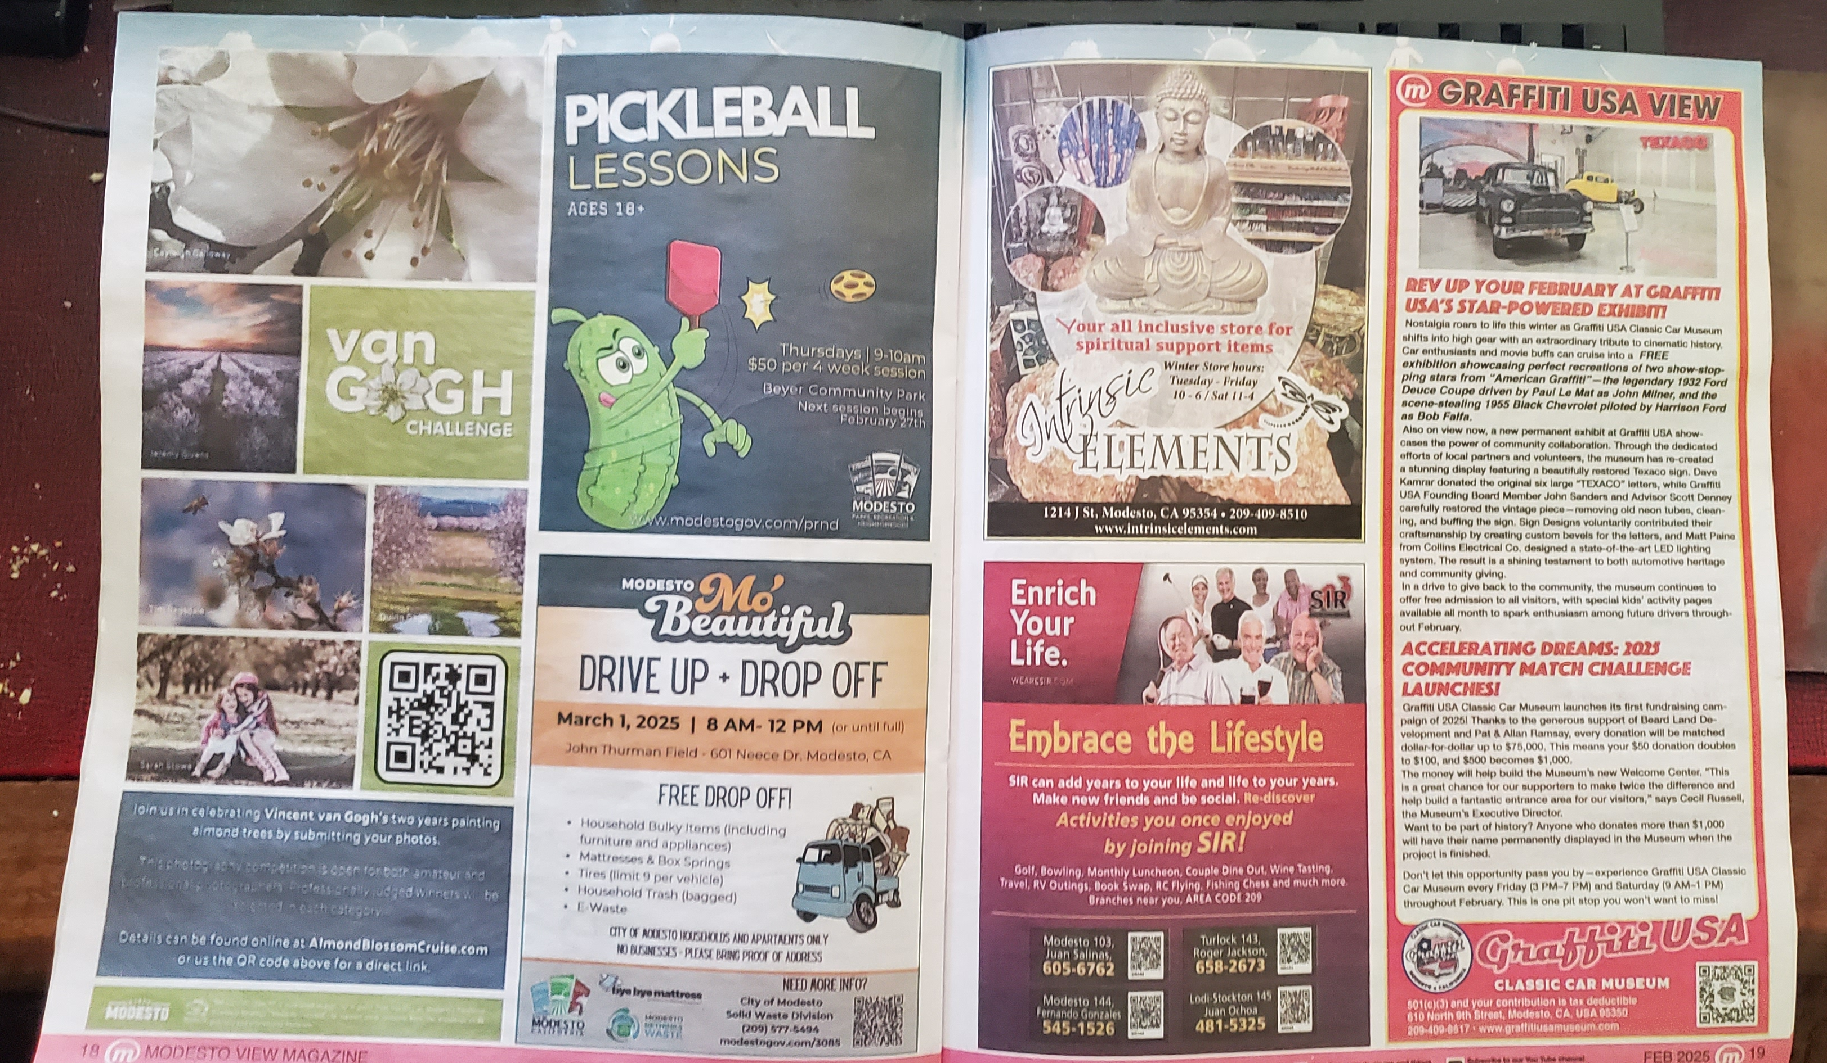
Modesto m-View (February edition)

Slide 32

Los Altos –
Mountain View

Slide 33
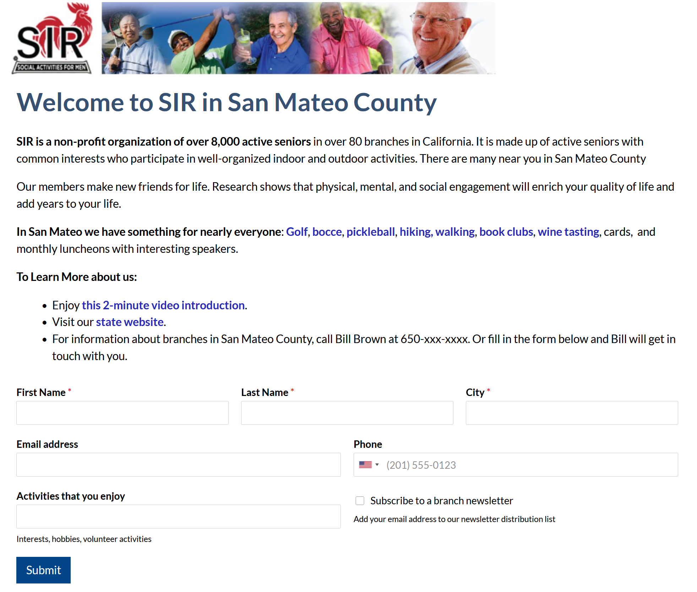

Slide 34

Los Altos –
Mountain View

Slide 35

Los Altos –
Mountain View

Slide 36

Los Altos –
Mountain View

Slide 37

Los Altos –
Mountain View

Slide 38

Two Tracks
One Mission
One Vision of the Future
Men’s
Selective
Social Club
Damian’s Model
Personal invite
Luncheon Focus
No Visibility
Senior’s
Community
Activities Club
Community Wide
On-Line Applications
Activities Focus
Known & Recognized

